Slide 1


Python Coding Session Conditional Statements and Loops
Introduction to Implementation Details and Usage

Slide 2

Introduction
Python Control flow statements are used to control the flow of execution in a Python program. They allow you to make decisions and repeat actions based on certain conditions. There are two main statements: conditional statements (if, else, elif) and Loops (for and while)

Slide 3
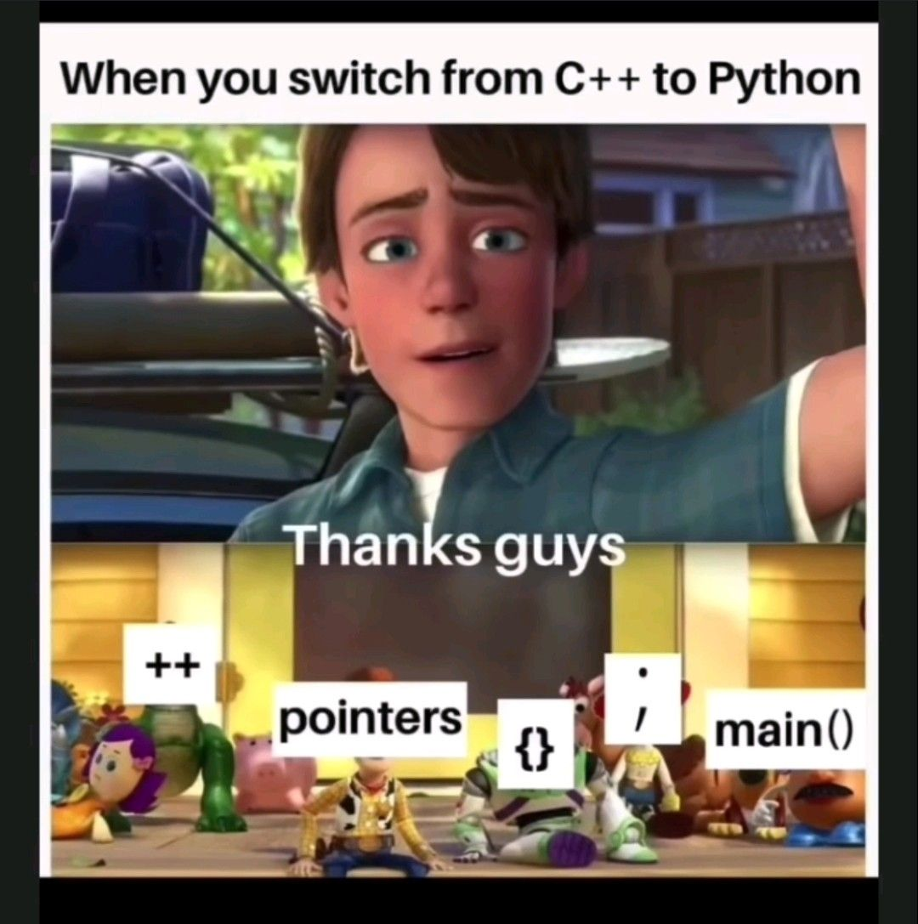
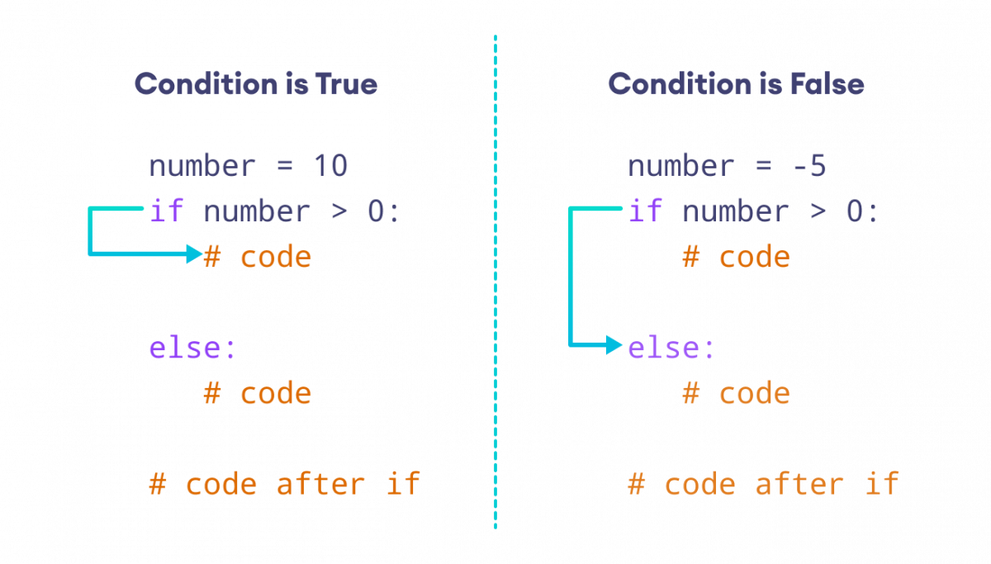
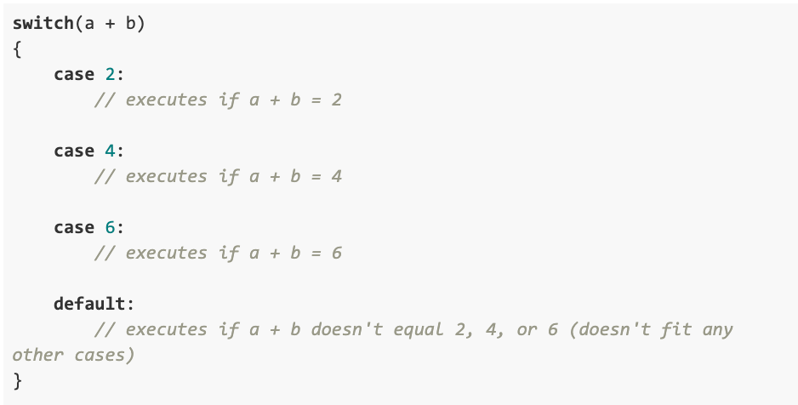
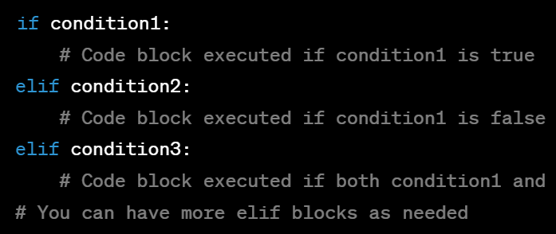
Python Conditional Statements

Slide 4
Loop Statement
Loops allow you to execute a block of code repeatedly based on a condition.
Python has two types of loops: for loop and while loop.
for loop:
Used to iterate over a sequence (e.g., list, tuple, string) or other iterable objects.
Python for loop needs one iterable object (Code block executed for each item in the iterable)
while loop:
Continues to execute a block of code as long as a specified condition is true.
Python while condition: # Code block executed as long as the condition is true

Slide 5
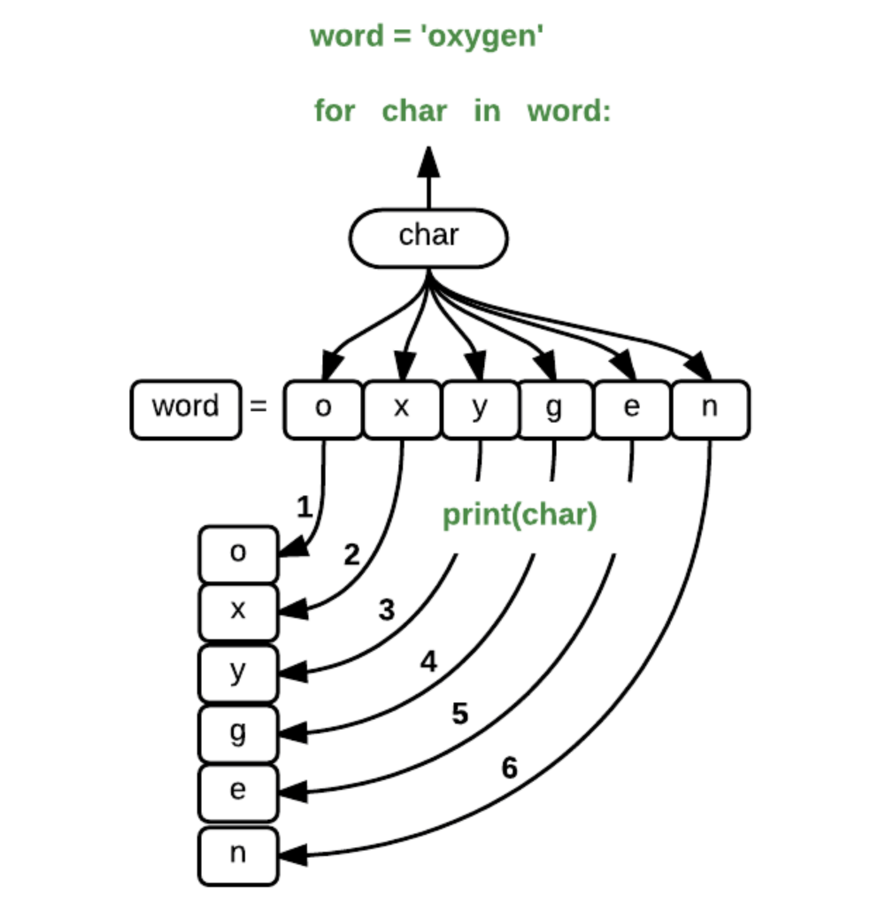

Slide 6
While Loop Statement

Slide 7
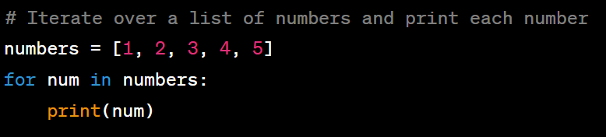
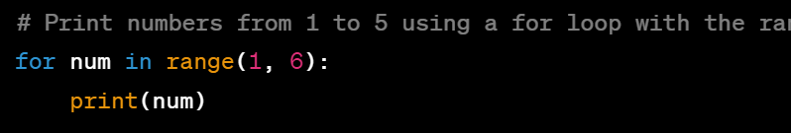
For Loop Statement

Slide 8
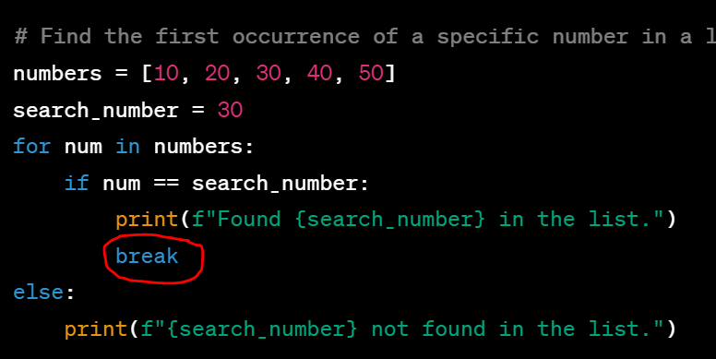
Break and Continue

Slide 9
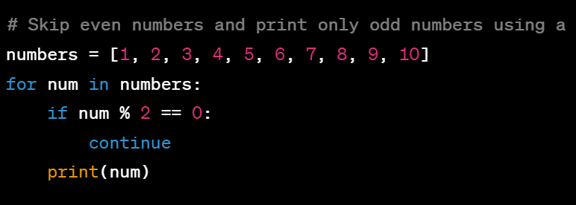

Slide 10
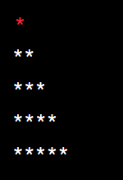
Exercises
Exercise 1: Print Even Numbers Write a program that prints all even numbers from 1 to 20.
Exercise 2: Sum of Digits Write a program that takes an integer from the user and calculates the sum of its digits.
Exercise 3: Print Triangle Write a program that takes a positive integer n from the user and prints a right-angled triangle of height n. For example, if n=5, the output should be:

